Slide 1

COM7401 Research Methods
Welcome – Week 1
Week 1 – Session 1

Slide 2


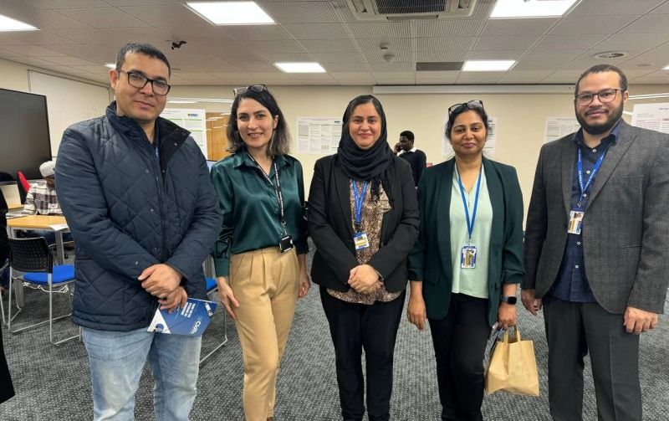
This is your teaching Team
You can contact us in a variety of ways – phone, email, Forum pages on Moodle and in our offices
You can also arrange an appointment where we can set aside some dedicated time to help.
Bren Tighe
Irum Feroz
Naveed Islam
Associate Professor & Module Leader
b.tighe@bolton.ac.uk
C2-11
Lecturer Computing & Module Tutor
i.feroz@bolton.ac.uk
C2-11
Programme Leader (AI) & Module Tutor
N.islam2@bolton.ac.uk
C2-07a

Slide 3
Indicative Module Timeline
Week 1
- Session 1
Week 1
- Session 2
Week 2
- Session 1
Week 2
- Session 2
Week 3
- Session 1
Week 3
- Session 2
Research Journey
Research Philosophy/ Paradigms
Research Questions
Literature Reviews
Research Design & Ethics
Sampling & Data Collection
Week 4
- Session 1
Week 4
- Session 2
Week 5
- Session 1
Week 5
- Session 2
Quantitative Data Analysis Techniques
Qualitative Data Analysis Techniques
Oral Defence Workshop
Assignment Support

Slide 4

Assessment Overview
Module Guide | Assessment Brief

Slide 5
Your portfolio at a glance
Part A – Written report
Part B – Recorded oral defence
2,500 words (±10%), fixed headings:
Research Background & Context (~400)
Critical Literature Review (~900)
Proposed Methodology (~900)
Reflection (~300)
4 minutes (±30 seconds)
State your research question(s) as submitted
Defend your proposal against one fixed methodological check
Your own, unaided understanding – no AI tools, no scripts
Report due at the end of Week 4 · Oral defence due at the end of Week 5 · Module Guide and Assessment Brief are on Moodle

Slide 6

By the end of the session, you should be able to…
Define research and explain why it matters in CS, IS and CY
Distinguish types and kinds of research
Recognise the qualities of good research
Analyse a real research case and its impact

Slide 7

What’s it all about
Twenty-First Century Postgraduate Research
Research is a purposeful and organized endeavour which uses strategies, processes and defined methods to collect data or evidence for analysis to uncover new information, create better understanding of a topic or simply to restate existing findings.
There are different types of research methods which use different tools for data collection.
Research methods also provide a means to ensure that the practicalities of research, the tools used, and the process in and of itself will help you achieve a positive outcome to your Masters dissertation and beyond.

Slide 8
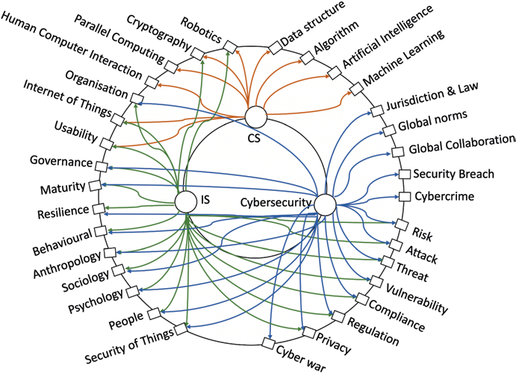
Research in Computing
Computer Science (CS), Information Systems (IS), and Cybersecurity (CY) are related but distinct fields of study
CS focus on theories and underlying principles of Computing that IS, and CY take advantage of and leverage
Multidisciplinary research: Examines phenomena from multiple disciplinary perspectives Example: CY research combining software engineering and law
Interdisciplinary research: Explores overlaps between disciplines for new insights Example: Integrated cybersecurity framework using computational mathematics
Conclusion: Need for significant coupling of CS, DA, and CY research in academic and industry environments

Slide 9
Types and kinds of research
Two broad types
Common kinds
Basic / fundamental – knowledge for its own sake, with or without an application
Applied – answers real-world problems: output, quality, function, cost
Descriptive – describes a new or little-known phenomenon
Exploratory – investigates an unfamiliar problem
Experimental – tests the effect of one variable; cause and effect
Theoretical – examines and extends weak or incomplete theory

Slide 10
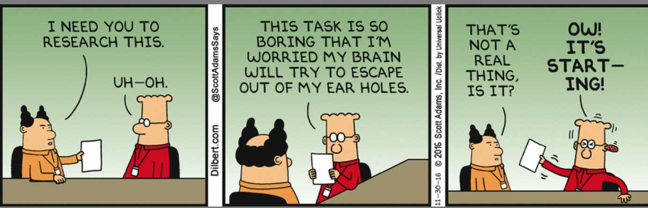
5 Qualities of a good researcher (Regoniel, 2014)
A good researcher manifests thirst for new information
A good researcher has a keen sense of things around him.
A good researcher likes to reflect or think about the things he encounters.
A good researcher must be intelligent enough to express his ideas.
A good researcher applies a systematic approach in assessing situations.
Regoniel, P. (2014) 5 Qualities of a Good Researcher. [Online] Available from
https://simplyeducate.me/2012/10/24/5-qualities-of-a-good-researcher. [Accessed 20 January 2023].

Slide 11
What makes for good research?
Sound and trustworthy
Meaningful and sustained
Builds on the work of other researchers
Replicable and doable
Valid and verifiable
Generalisable to other settings
Tied to theory; suggests future research
Cyclical and incremental – generates new questions
Applied – addresses a real problem and states its variables
Driven by genuine interest

Slide 12
The Research Process – linear
Identify Research Problem
Define a clear, focused area of study
Literature Review
Systematically search and analyze existing research
Developing Research Questions/Hypotheses
Formulate specific, answerable questions
Selecting Appropriate Methodologies
Choose quantitative, qualitative, or mixed methods
Identify gaps in current knowledge
Ensure the problem is relevant and significant
Data Collection and Analysis
Identify key theories, methods, and findings
Synthesize information to provide context for your study
Develop testable hypotheses based on literature
Ensure questions align with research goals
Consider study design (e.g., experimental, observational)
Ensure methodology aligns with research questions
Drawing Conclusions and Reporting Findings
Interpret results in context of research questions
Discuss implications and limitations of findings
Present results clearly and concisely in reports or papers
Implement chosen methods to gather data
Use appropriate tools and techniques for analysis
Ensure data quality and reliability

Slide 13

Research Impact Case Study Analysis
Duration: about 60 minutes, in groups
Objective: analyse a real research case to identify its type of research, the qualities of good research it shows, and its impact in the real world.
Your worksheet has five parts:
1. Case study analysis – the problem, outputs, pathways to impact, types and evidence of impact
2. Impact pathway mapping – from initial problem to final impact
3. Reverse engineering the impact – swap cases with another group: challenges, alternative pathways, ways to extend the impact
4. Presentation and reflection – share your analysis
5. Personal impact reflection – who could benefit from your own research?
key Research Attributes
Systematic
Empirical
Replicable
Objective
Valid
Reliable
Generalizable
Ethical
Original
Significant
Interest

Slide 14
Reflection & Writing – 10 mins
Spend 10 minutes just writing. Reflect on today’s session and capture any early ideas for your own research.
What surprised you about research today?
Which broad topic area interests you, and why?
Which research skills do you already have – and which do you need to develop?

Slide 15
Summary
We’re looking at the process of research to help you with your dissertation
This includes things like the practices and processes of research
Our Job is to get you through successfully
And the module team will help you get results
There are loads of tools to help you
From research databases to tools to make referencing as easy as falling down
All the take aways are on Moodle
We will make sure you have everything that you need to succeed.
You will be confused
But from that confusion will come a clear understanding of the reality you chose to
Research.
Couple across domains for greater inspiration
Remember computing is a broad domain of knowledge with many cross over areas undertake research

Slide 16
Next: Research Philosophy and Paradigms
This afternoon: ontology, with a live debate
Before you arrive, if you haven’t already:
The four cheat sheets – Ontology, Epistemology, Axiology and Doxology
Introduction to positivism, interpretivism and critical theory (reading)
Al-Ababneh (2020) – Linking ontology, epistemology and research methodology (reading)
After this afternoon: the Philosophical Stance Task – on your own, then completed in Thursday’s Zoom

Slide 17

From this point on…you’re a scientific researcher!
Congratulations
Mad or otherwise
Questions???

